Slide 1
SEMANTIC NEURAL MODEL APPROACH FOR FACE RECOGNITION FROM SKETCH
Team-9
CHANDANA
SANDHYA REDDY
RAGHUPATHI REDDY

Slide 2
Introduction
Face sketch synthesis and recognition have wide range of applications in law enforcement. Despite the impressive progresses have been made in faces sketch and recognition, most existing researches regard them as two separate tasks
This paper aims at designing a framework that can simultaneously synthesize realistic face sketch image with which the domain discrepancy is reduced and extract discriminative face feature for face sketch recognition

Slide 3
Existing Sytem Drawbacks
Difficulties to obtain better performance
Inaccurate estimations of the missing pixels
High prediction complexity for large datasets

Slide 4
Proposed System
So, we propose a semantic neural approach for face photo recognition from sketch, which incorporates a self-interest process into the residual block, utilizing the connection between functions to selectively decorate.
Simultaneously, residual researching can prevent the distinctive features' attributes from being lost.

Slide 5
MILESTONE 1
Collection of Datasets
Images are preprocessed
Read and plotted the images and sketches

Slide 6
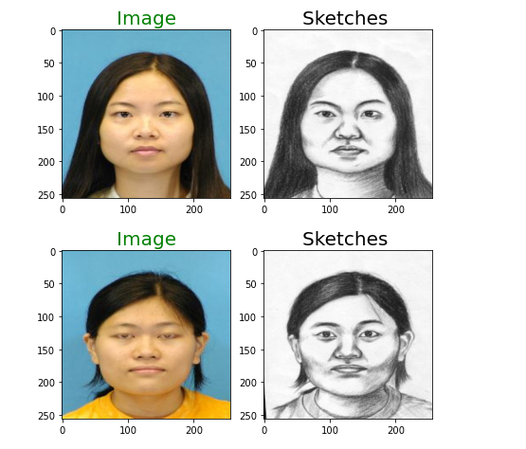
Result

Slide 7
MILESTONE 2
preprocessed the data by splitting as a training and validation set
A CNN Model is created
Compiling the model: The code compiles the model by specifying the loss function, optimizer, and evaluation metric(s) to use during training.

Slide 8
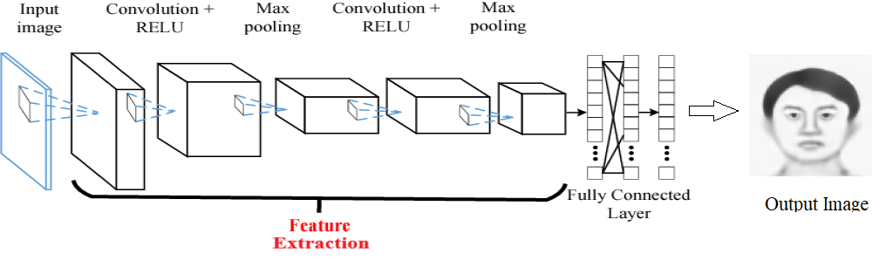
CONVOLUTIONAL NEURAL NETWORK

Slide 9
Hyper Parameters used in this model
filters:The encoder has 16 filters in the first convolutional layer and the decoder has 512 filters in the first convolutional layer.
kernel_size: The kernel size is set to (3, 3) for all convolutional layers.
activation:The ReLU activation function is used for all convolutional layers.
Padding: The padding is set to 'same' for all convolutional layers.

Slide 10
Hyper Parameters
pool_size: The pooling window size is set to (2, 2) for both MaxPooling layers.
Optimizer: Adam optimizer is used with a learning rate of 0.001.
loss: Mean absolute error (MAE) is used as the loss function.
metrics: The accuracy is used as the evaluation metric.
epochs: The model is trained for 50 epochs.

Slide 11
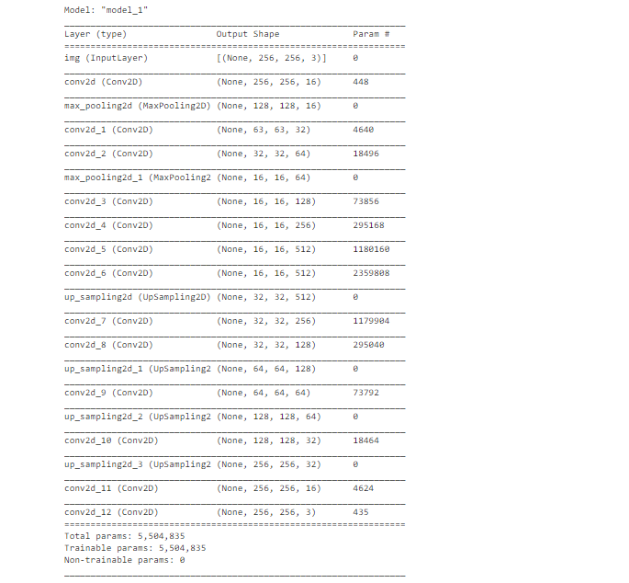

Slide 12
Milestone 3
Training the model

Slide 13
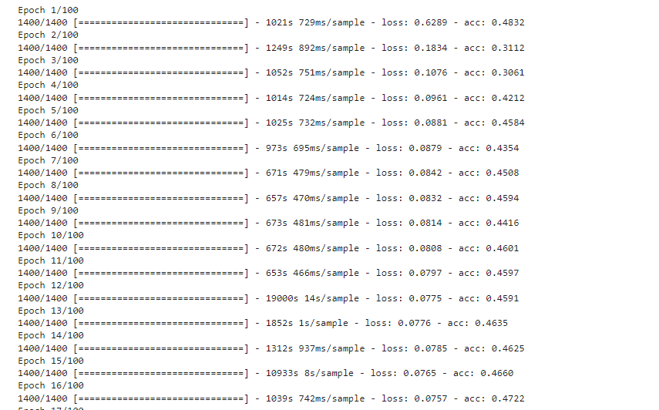

Slide 14
We trained the model using dataset which consists of 1400 images with corresponding sketches.
This model was trained for 100 epochs with same dataset in order to bring the best results.
Then after training we tested the model using 104 images. This model is supposed to return the corresponding photo when the sketch is fed.

Slide 15
Milestone 4
Evaluating the model:
evaluating the performance of the trained model on the test data using the loss and accuracy metrics.
Generating output

Slide 16
Performance Metrics
Due to the difference of modality between face photo and face sketch, traditional exemplar-based methods often lead to missed texture details and deformation while synthesizing sketches.
When comparing with real-time photo the characteristics of the face are unrecognizable.
Therefore, the objective is to find the original photo with a given sketch with maximum accuracy.

Slide 17
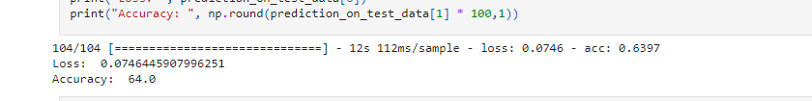
Result
The experiment was successful and the model returned the image as a grayscale image with the coordinates to the real image. The accuracy rate is 64.0% and loss percentage is 0.074.

Slide 18
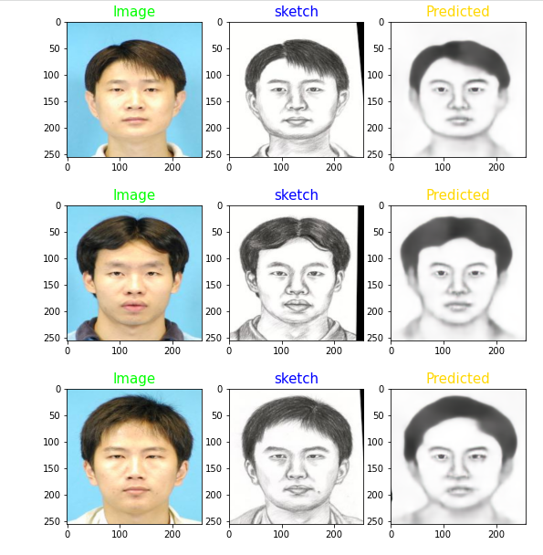
Result

Slide 19
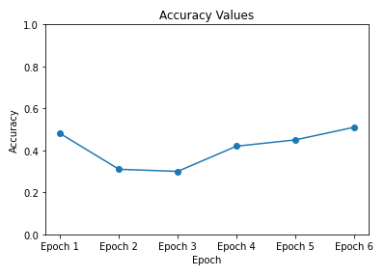

Slide 20
